Slide 1
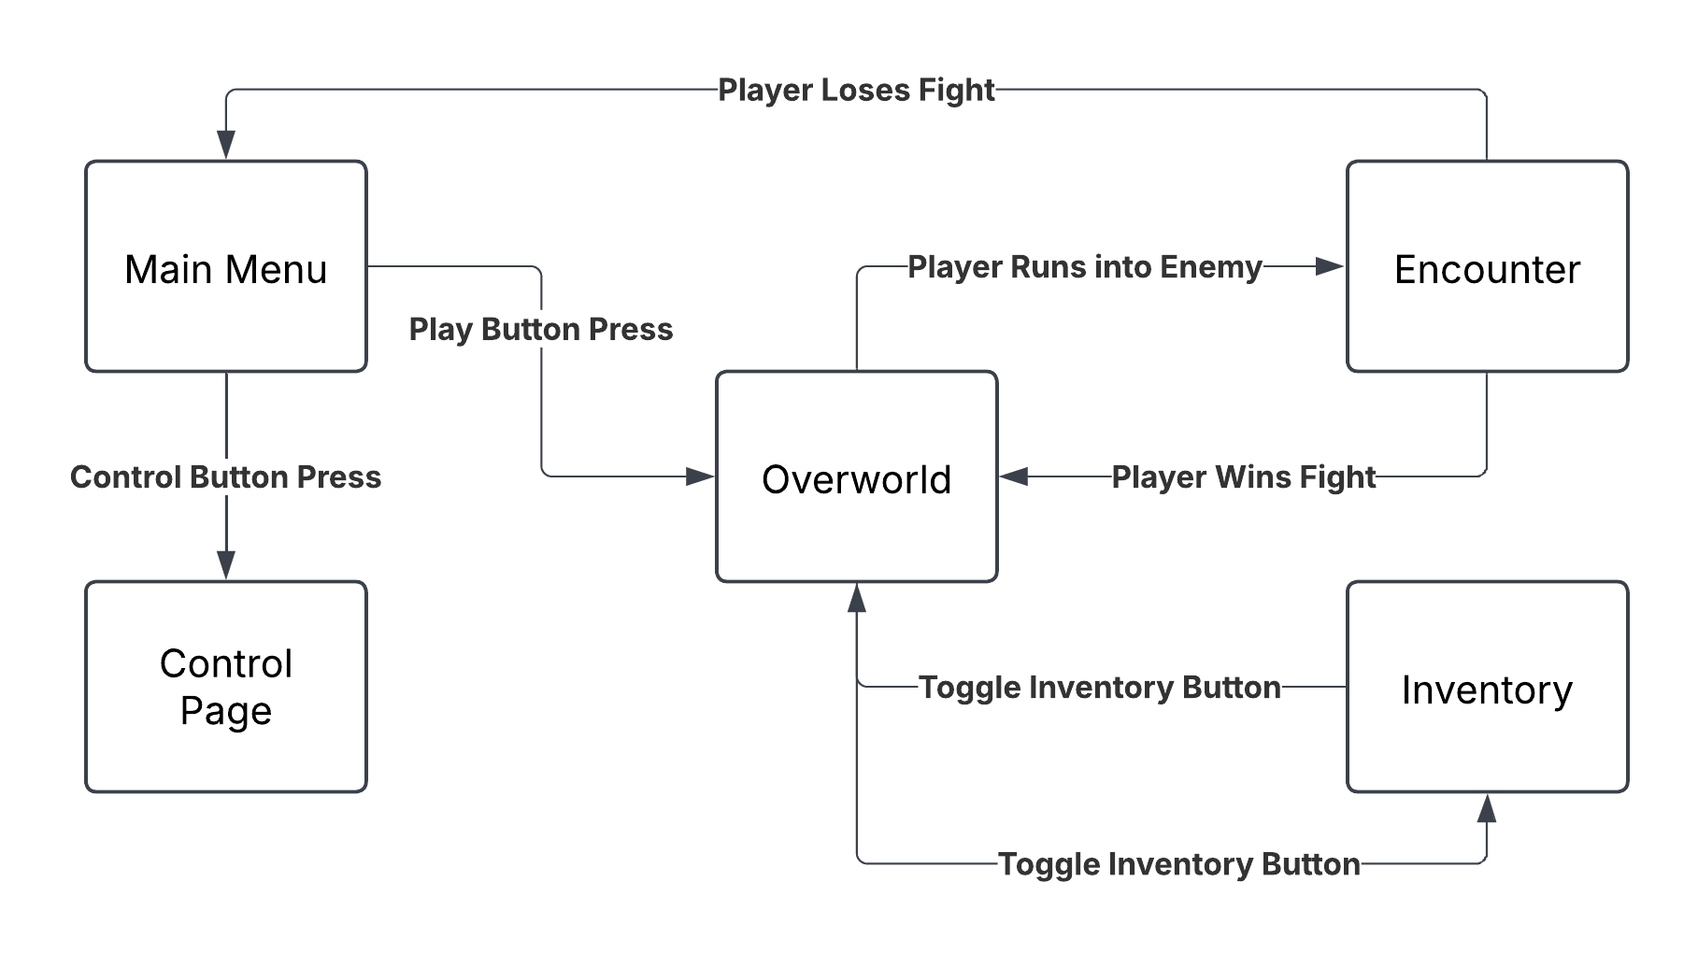
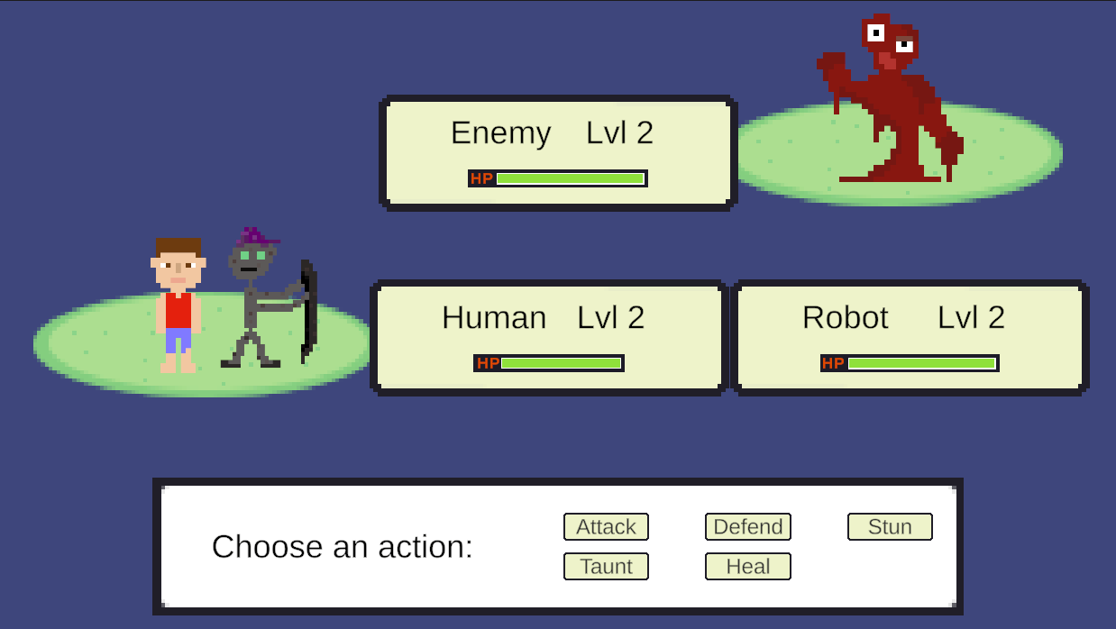
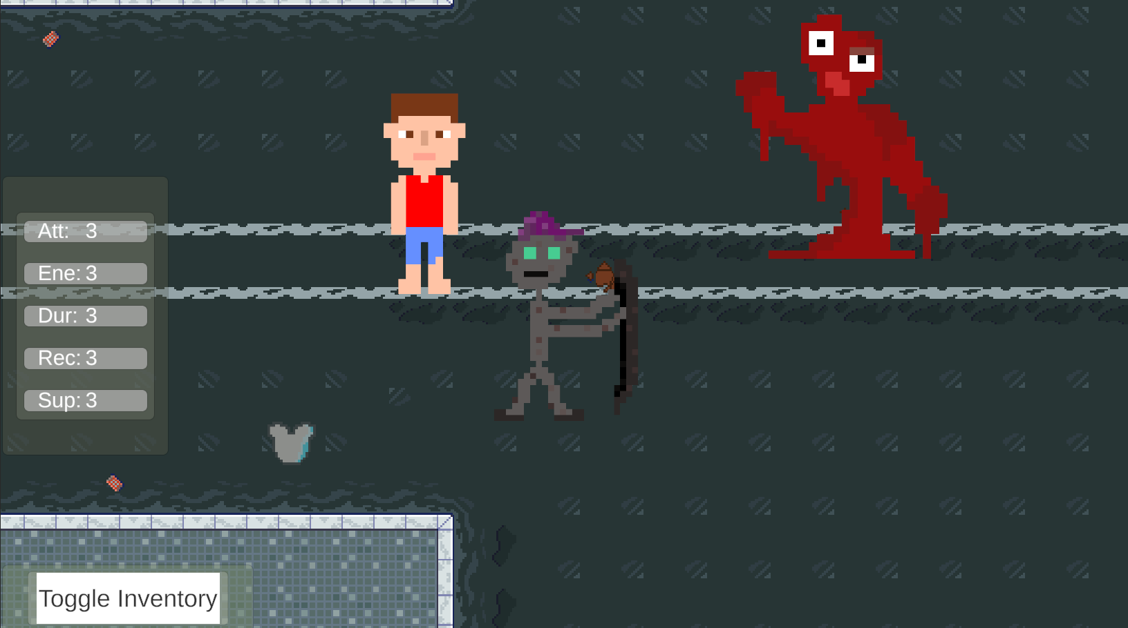

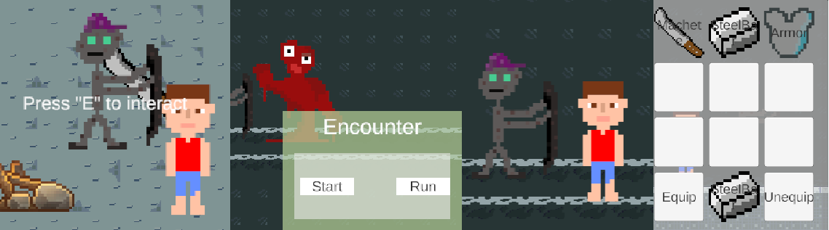
School of Electrical Engineering and Computer Science CS 362 Software Engineering II
(Winter 2025)
PROTECT HUMANITY
Graham Glazner, Kaden Allen, Wyatt Fujikawa, Jonathan Hotchkiss, Owen Wickman, Douglas Sandford, Joseph Liefeld
High-level METHODOLOGY
Main Menu
Interacts directly with control menu, overworld, and encounters
Controls
Receives actions from main menu and passes information back
Overworld
Provides data for character interaction with items and enemies
Encounter
Reacts with combat scenes to send user to correct screen with the current stats
Inventory
Stores character information and item abilities to pass to overworld for display
Abstract
We want to create an engaging video game that discourages violence and emphasizes the sanctity of life. Protect Humanity will differ from the others because the focus will be on protecting a non-player character.
Protect Humanity is a role-playing game. The player plays a robot who travels through a dangerous, apocalyptic world. Humanity is escaping to Mars. The robot’s job is to escort the last living human safely to the launchpad. The player can equip items to improve their stats. The map includes enemy encounters that enter the player into a turn-based battle. For each turn, the player must choose an action to keep the human alive. Each round, the human will also act, though they may not always be helpful. If the robot dies in combat, but the human manages to defeat the enemy, a new identical robot replaces the old one. The game ends when the human dies or when the final enemy is defeated.
Protect Humanity Features
Turn-Based Combat Encounters
Take turns fighting with opportunities to rethink strategy between each round
Randomized enemy targeting to keep the player on their feet
Human npc takes actions independently for an added challenge
NPC Following Movement
Human character follows behind user-controlled robot
Intuitive Controls
Simplistic movement to improve user experience
Clear Instructions for other actions
Inventory System
Equippable items to enhance character fighting abilities
Swap items with equip/unequip buttons

